Slide 1
Foundations of Cryptography plain RSA signature, RSA-FDH, millionaires’ problem, oblivious transfer, garbled circuit
LiangFeng Zhang
zhanglf@shanghaitech.edu.cn
SIST, ShanghaiTech, 2019F

Slide 2
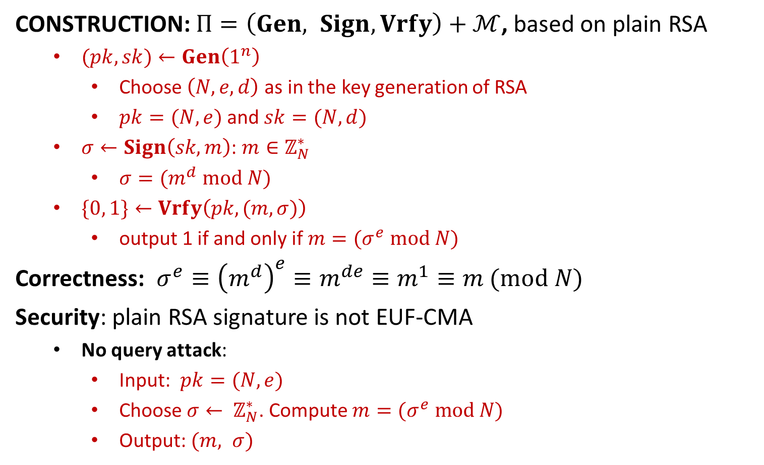
Plain RSA Signature
CONSTRUCTION: $Π=\left(Gen, Sign, Vrfy\right)+ℳ$, based on plain RSA
$(pk,sk)←Gen\left(1^{n}\right)$
Choose $\left(N,e,d\right)$ as in the key generation of RSA
$pk=(N, e)$and $sk=(N, d)$
$σ←Sign\left(sk, m\right)$: $m∈ℤ_{N}^{∗}$
$σ=(m^{d} mod N)$
$\{0, 1\}←Vrfy\left(pk, (m,σ)\right)$
output 1 if and only if $m=(σ^{e} mod N)$
Correctness: $σ^{e}≡{\left(m^{d}\right)}^{e}≡m^{de}≡m^{1}≡m (mod N)$
Security: plain RSA signature is not EUF-CMA
No query attack:
Input: $pk=(N,e)$
Choose $σ← ℤ_{N}^{∗}$. Compute $m=(σ^{e} mod N)$
Output: $(m, σ)$

Slide 3
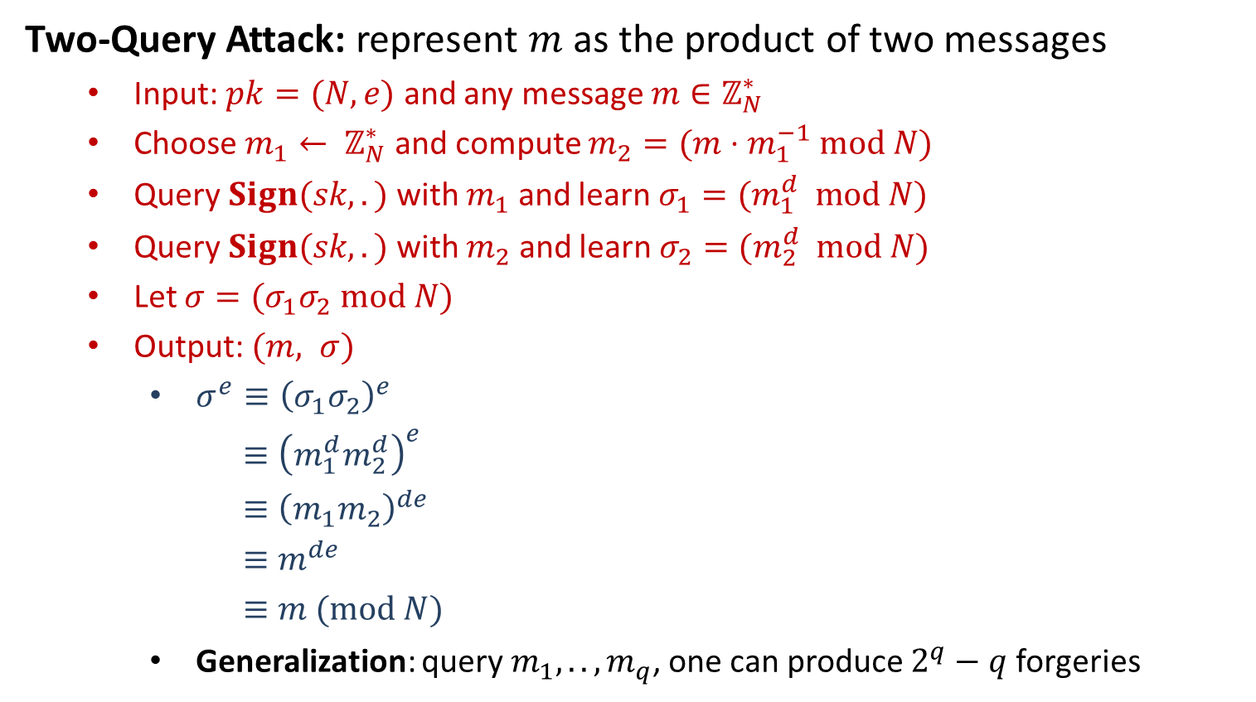
Plain RSA Signature
Two-Query Attack: represent $m$ as the product of two messages
Input: $pk=(N,e)$ and any message $m∈ℤ_{N}^{∗}$
Choose $m_{1}← ℤ_{N}^{∗}$ and compute $m_{2}=(m⋅m_{1}^{−1} mod N)$
Query $Sign(sk, .)$ with $m_{1}$ and learn $σ_{1}=(m_{1}^{d} mod N)$
Query $Sign(sk, .)$ with $m_{2}$ and learn $σ_{2}=(m_{2}^{d} mod N)$
Let $σ=(σ_{1}σ_{2} mod N)$
Output: $(m, σ)$
$σ^{e}≡{\left(σ_{1}σ_{2}\right)}^{e}$
$≡{\left(m_{1}^{d}m_{2}^{d}\right)}^{e}$
$≡{\left(m_{1}m_{2}\right)}^{de}$
$≡m^{de}$
$≡m (mod N)$
Generalization: query $m_{1},..,m_{q}$, one can produce $2^{q}−q$ forgeries

Slide 4
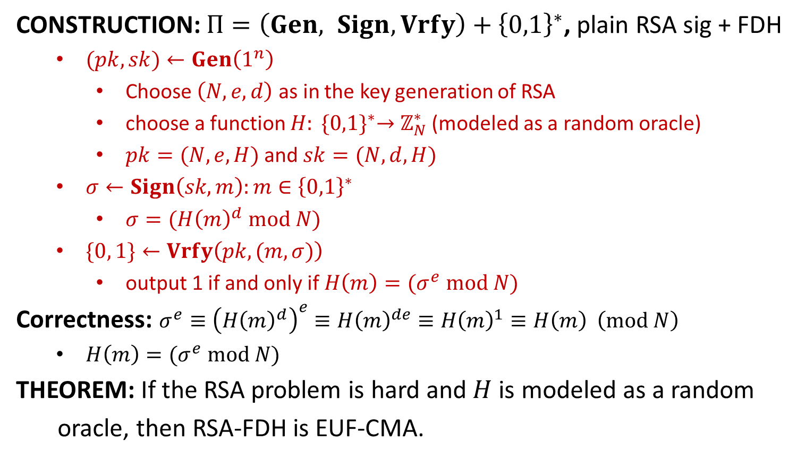
RSA-FDH (full-domain hash)
CONSTRUCTION: $Π=\left(Gen, Sign, Vrfy\right)+{\left\{0,1\right\}}^{∗}$, plain RSA sig + FDH
$(pk,sk)←Gen\left(1^{n}\right)$
Choose $\left(N,e,d\right)$ as in the key generation of RSA
choose a function $H: {\{0,1\}}^{∗}→$ $ℤ_{N}^{∗}$ (modeled as a random oracle)
$pk=(N, e, H)$and $sk=(N, d,H)$
$σ←Sign\left(sk, m\right):m∈{\left\{0,1\right\}}^{∗}$
$σ=({H\left(m\right)}^{d} mod N)$
$\{0, 1\}←Vrfy\left(pk, (m,σ)\right)$
output 1 if and only if $H\left(m\right)=(σ^{e} mod N)$
Correctness: $σ^{e}≡{\left({H\left(m\right)}^{d}\right)}^{e}≡{H\left(m\right)}^{de}≡{H\left(m\right)}^{1}≡H\left(m\right) \left(mod N\right)$
$H\left(m\right)=(σ^{e} mod N)$
THEOREM: If the RSA problem is hard and$H$is modeled as a random
oracle, then RSA-FDH is EUF-CMA.

Slide 5
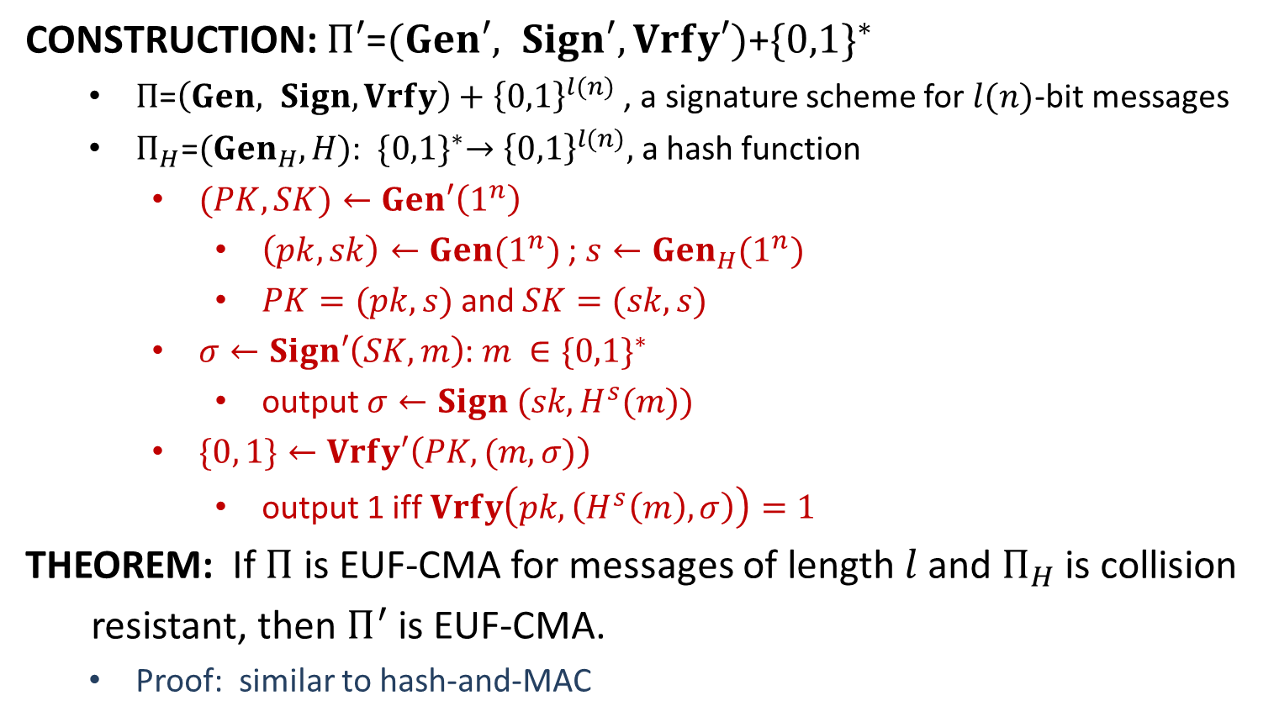
Hash-and-Sign
CONSTRUCTION: $Π′\text{=}(Gen′, Sign′, Vrfy′)\text{+}{\{0,1\}}^{∗}$
$Π\text{=}\left(Gen, Sign, Vrfy\right)+{\left\{0,1\right\}}^{l(n)}$ , a signature scheme for $l(n)$-bit messages
$Π_{H}\text{=}({Gen}_{H},H)$: ${\{0,1\}}^{∗}→{\left\{0,1\right\}}^{l(n)},$ a hash function
$(PK,SK)←Gen′\left(1^{n}\right)$
$\left(pk,sk\right)←Gen(1^{n})$; $s←{Gen}_{H}(1^{n})$
$PK=(pk, s)$and $SK=(sk, s)$
$σ←Sign′\left(SK, m\right)$: $m ∈{\{0,1\}}^{∗}$
output $σ←Sign (sk, H^{s}(m))$
$\{0, 1\}←Vrfy′\left(PK, (m,σ)\right)$
output 1 iff $Vrfy\left(pk, \left(H^{s}\left(m\right), σ\right)\right)=1$
THEOREM: If $Π$ is EUF-CMA for messages of length$l$and $Π_{H}$ is collision
resistant, then $Π^{′}$ is EUF-CMA.
Proof: similar to hash-and-MAC

Slide 7
Beyond Secure Communication
Secure Communication: confidentiality + integrity
There are two parties, Alice and Bob, who want to communicate securely.
Confidentiality: private communication channel
Integrity: authenticated communication channel
There is an adversary Charlie, who may wiretap or modify the channel.
Countermeasures:
PrivKE and PubKE: confidentiality
MAC and SIG: Integrity
Secure Computation: confidentiality + integrity
There are two parties, Alice and Bob, who are communicating securely.
Alice (or Bob) may be an adversary and try to learn more information about Bob (or Alice) than what he is authorized to learn.

Slide 8






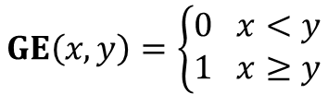


Millionaires’ Problem
Who is wealthier?
$$GE\left(x,y\right)=\left\{\begin{aligned}0 x<y \\ 1 x≥y\end{aligned}\right.$$
Millionaire Alice
$$GE\left(x,y\right)=?$$
Millionaire Bob
$x$ million dollars
$y$ million dollars
I have $x$ million dollars
$$GE\left(x,y\right)=1$$
Millionaire Alice
Alice: Bob learns too much about me?!
Millionaire Bob
$x$ million dollars
Can we learn $GE(x,y)$ without revealing
$x$ or$y$to the other person?
$y$ million dollars
I am wealthier!
Work harder!
A.C.C. Yao 1982
Turing Award 2000

Slide 9
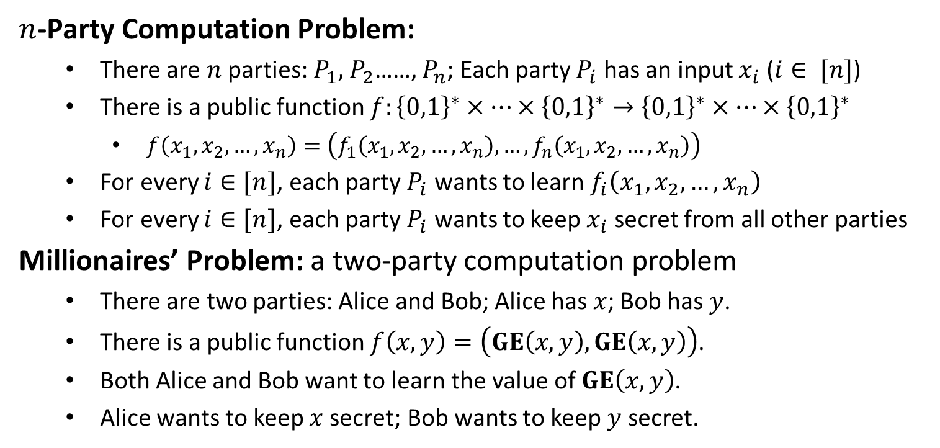
Multi-Party Computation
$n$-Party Computation Problem:
There are $n$ parties: $P_{1},$ $P_{2}$……, $P_{n}$; Each party $P_{i}$ has an input $x_{i}$ ($i∈ [n]$)
There is a public function $f:{\left\{0,1\right\}}^{∗}×⋯×{\left\{0,1\right\}}^{∗}→{\left\{0,1\right\}}^{∗}×⋯×{\left\{0,1\right\}}^{∗}$
$f\left(x_{1},x_{2},…,x_{n}\right)=\left(f_{1}\left(x_{1},x_{2},…,x_{n}\right), …, f_{n}\left(x_{1},x_{2},…,x_{n}\right)\right)$
For every $i∈[n]$, each party $P_{i}$ wants to learn $f_{i}\left(x_{1},x_{2},…,x_{n}\right)$
For every $i∈[n]$, each party $P_{i}$ wants to keep $x_{i}$ secret from all other parties
Millionaires’ Problem: a two-party computation problem
There are two parties: Alice and Bob; Alice has $x$; Bob has $y$.
There is a public function $f\left(x,y\right)=\left(GE\left(x,y\right), GE\left(x,y\right)\right)$.
Both Alice and Bob want to learn the value of $GE\left(x,y\right)$.
Alice wants to keep $x$secret; Bob wants to keep $y$ secret.

Slide 10
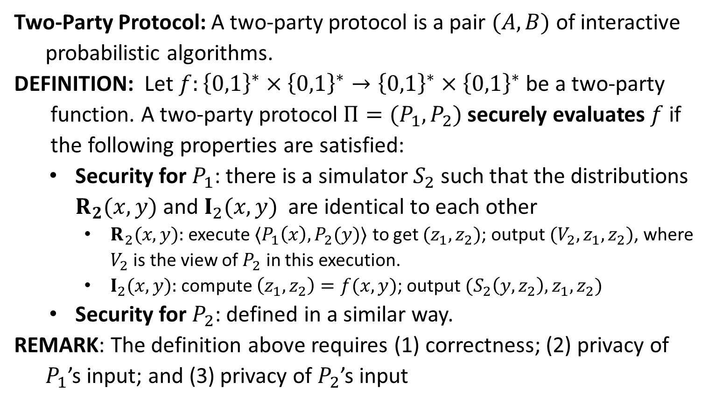
Secure Two-Party Protocol
Two-Party Protocol: A two-party protocol is a pair $(A,B)$of interactive
probabilistic algorithms.
DEFINITION: Let $f:{\left\{0,1\right\}}^{∗}×{\left\{0,1\right\}}^{∗}→{\left\{0,1\right\}}^{∗}×{\left\{0,1\right\}}^{∗}$ be a two-party
function. A two-party protocol $Π=(P_{1},P_{2})$securely evaluates $f$ if
the following properties are satisfied:
Security for $P_{1}$: there is a simulator $S_{2}$ such that the distributions $R_{2}(x,y)$ and $I_{2}(x,y)$ are identical to each other
$R_{2}(x,y):$ execute $〈P_{1}\left(x\right),P_{2}(y)〉$ to get $(z_{1},z_{2})$; output $(V_{2},z_{1},z_{2})$, where $V_{2}$ is the view of $P_{2}$ in this execution.
$I_{2}(x,y):$ compute $\left(z_{1},z_{2}\right)=f(x,y)$; output $(S_{2}\left(y,z_{2}\right), z_{1},z_{2})$
Security for $P_{2}$: defined in a similar way.
REMARK: The definition above requires (1) correctness; (2) privacy of
$P_{1}$’s input; and (3) privacy of $P_{2}$’s input

Slide 12


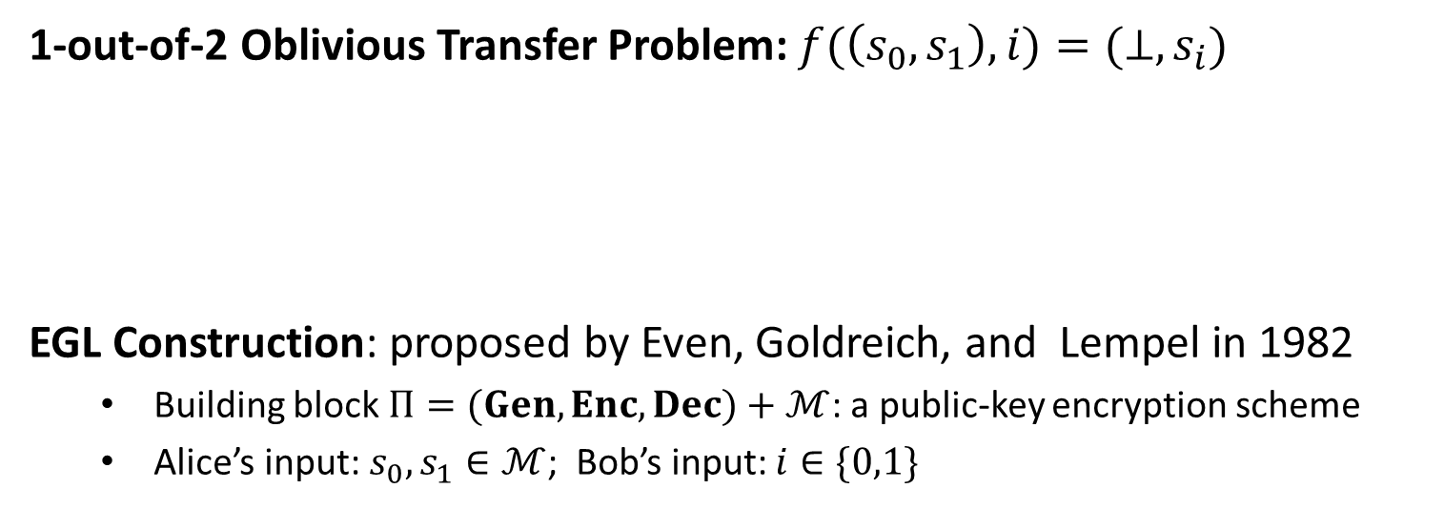




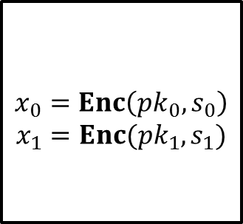
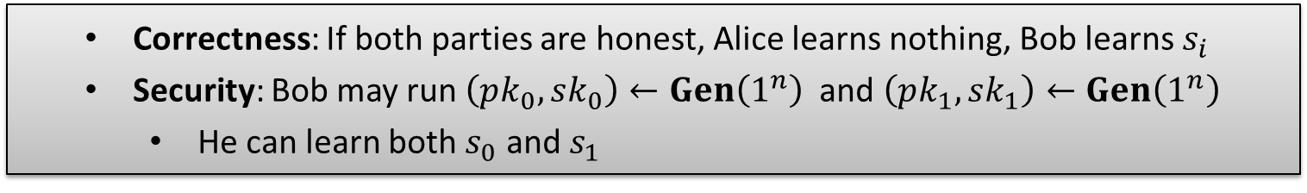

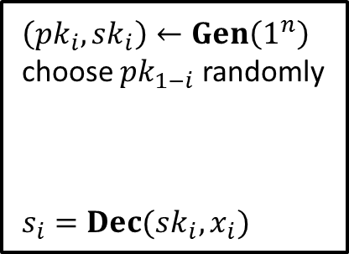


Oblivious Transfer
1-out-of-2 Oblivious Transfer Problem: $f(\left(s_{0},s_{1}\right),i)=(⊥,s_{i})$
EGL Construction: proposed by Even, Goldreich, and Lempel in 1982
Building block $Π=(Gen, Enc, Dec)+ℳ$: a public-key encryption scheme
Alice’s input: $s_{0},s_{1}∈ℳ$; Bob’s input: $i∈\{0,1\}$
$$s_{0},s_{1}$$
$$i∈\{0,1\}$$
$$⋮$$
$$s_{i}$$
Alice
Bob
Correctness: If both parties are honest, Alice learns nothing, Bob learns $s_{i}$
Security: Bob may run $\left(pk_{0},sk_{0}\right)←Gen\left(1^{n}\right)$ and $\left(pk_{1},sk_{1}\right)←Gen\left(1^{n}\right)$
He can learn both $s_{0}$ and $s_{1}$
$$s_{0},s_{1}$$
$$x_{0}=Enc\left(pk_{0},s_{0}\right)$$
$$x_{1}=Enc(pk_{1}, s_{1})$$
$\left(pk_{i},sk_{i}\right)←Gen\left(1^{n}\right)$
choose $pk_{1−i}$ randomly
$s_{i}=Dec(sk_{i},x_{i})$
$$i∈\{0,1\}$$
$$(pk_{0},pk_{1})$$
$$(x_{0},x_{1})$$
$$s_{i}$$
Alice
Bob

Slide 13

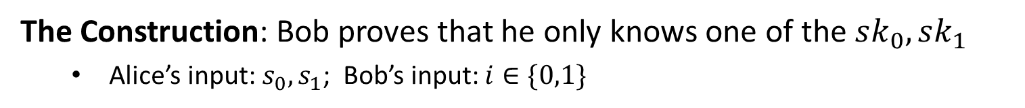

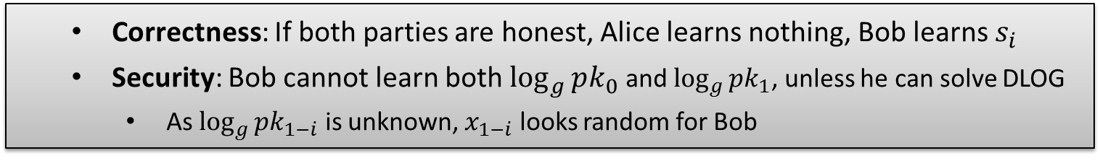


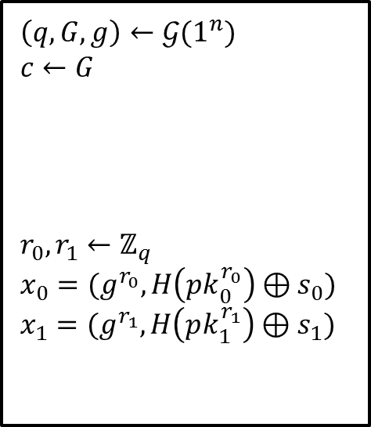
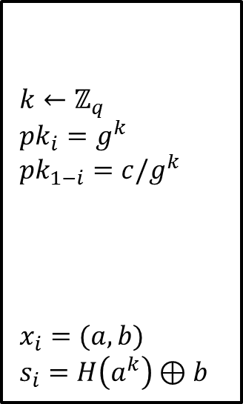

Bellare-Micali Construction
The Construction: Bob proves that he only knows one of the $sk_{0},sk_{1}$
Alice’s input: $s_{0},s_{1}$; Bob’s input: $i∈\{0,1\}$
$$s_{0},s_{1}$$
$\left(q,G,g\right)←𝒢(1^{n})$
$c←G$
$r_{0},r_{1}←ℤ_{q}$
$x_{0}=(g^{r_{0}}, H\left(pk_{0}^{r_{0}}\right)⊕s_{0})$
$x_{1}=(g^{r_{1}}, H\left(pk_{1}^{r_{1}}\right)⊕s_{1})$
$k←ℤ_{q}$
$pk_{i}=g^{k}$
$pk_{1−i}=c/g^{k}$
$x_{i}=(a,b)$
$s_{i}=H\left(a^{k}\right)⊕b$
$$i∈\{0,1\}$$
$$(q,G,g,c)$$
$$({pk}_{0},{pk}_{1})$$
$$(x_{0},x_{1})$$
$$s_{i}$$
Correctness: If both parties are honest, Alice learns nothing, Bob learns $s_{i}$
Security: Bob cannot learn both $\log_{g}{pk_{0}}$ and $\log_{g}{pk_{1}}$, unless he can solve DLOG
As $\log_{g}{pk_{1−i}}$ is unknown, $x_{1−i}$ looks random for Bob
Alice
Bob

Slide 15
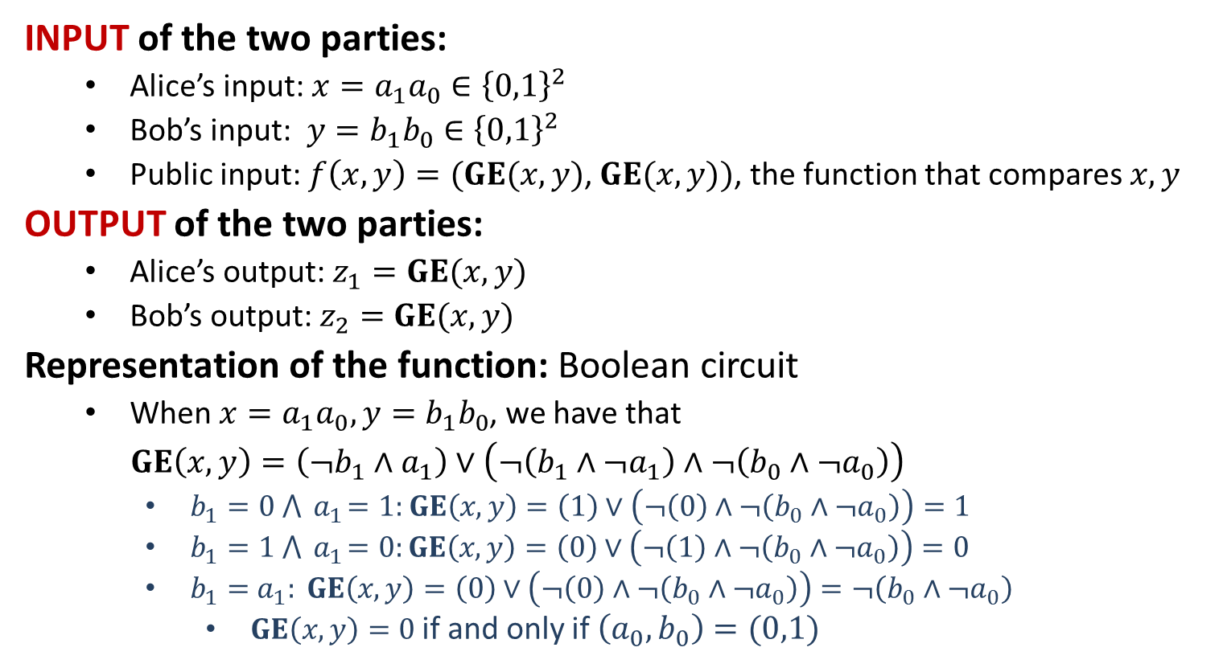
Millionaires’ Problem: Solution
INPUT of the two parties:
Alice’s input: $x=a_{1}a_{0}∈{\left\{0,1\right\}}^{2}$
Bob’s input: $y=b_{1}b_{0}∈{\left\{0,1\right\}}^{2}$
Public input: $f\left(x,y\right)=(GE(x,y)$, $GE(x,y))$, the function that compares $x,y$
OUTPUT of the two parties:
Alice’s output: $z_{1}=GE(x,y)$
Bob’s output: $z_{2}=GE(x,y)$
Representation of the function: Boolean circuit
When $x=a_{1}a_{0}, y=b_{1}b_{0}$, we have that
$GE\left(x,y\right)=\left(¬b_{1}∧a_{1}\right)∨\left(¬\left(b_{1}∧¬a_{1}\right)∧¬\left(b_{0}∧¬a_{0}\right)\right)$
$b_{1}=0 ⋀{ a}_{1}=1:$ $GE\left(x,y\right)=\left(1\right)∨\left(¬\left(0\right)∧¬\left(b_{0}∧¬a_{0}\right)\right)=1$
$b_{1}=1 ⋀{ a}_{1}=0:GE\left(x,y\right)=\left(0\right)∨\left(¬\left(1\right)∧¬\left(b_{0}∧¬a_{0}\right)\right)=0$
$b_{1}={ a}_{1}: GE\left(x,y\right)=\left(0\right)∨\left(¬\left(0\right)∧¬\left(b_{0}∧¬a_{0}\right)\right)=¬\left(b_{0}∧¬a_{0}\right)$
$GE\left(x,y\right)=0$if and only if $\left(a_{0},b_{0}\right)=(0,1)$

Slide 16


(1) Alice: $f$ $→$ Boolean circuit $BC(f)$
$$GE\left(x,y\right)=\left(¬b_{1}∧a_{1}\right)∨\left(¬\left(b_{1}∧¬a_{1}\right)∧¬\left(b_{0}∧¬a_{0}\right)\right)$$
$$1$$
$$2$$
$$3$$
$$4$$
$$5$$
$$6$$
$$7$$
$$8$$
$$9$$
$$10$$
$$11$$
$$12$$
$$13$$
$$14$$
$$15$$
$$16$$
$$GE(x,y)$$

Slide 17
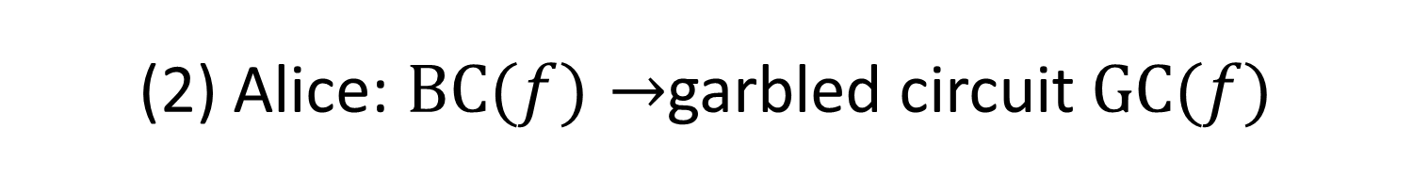
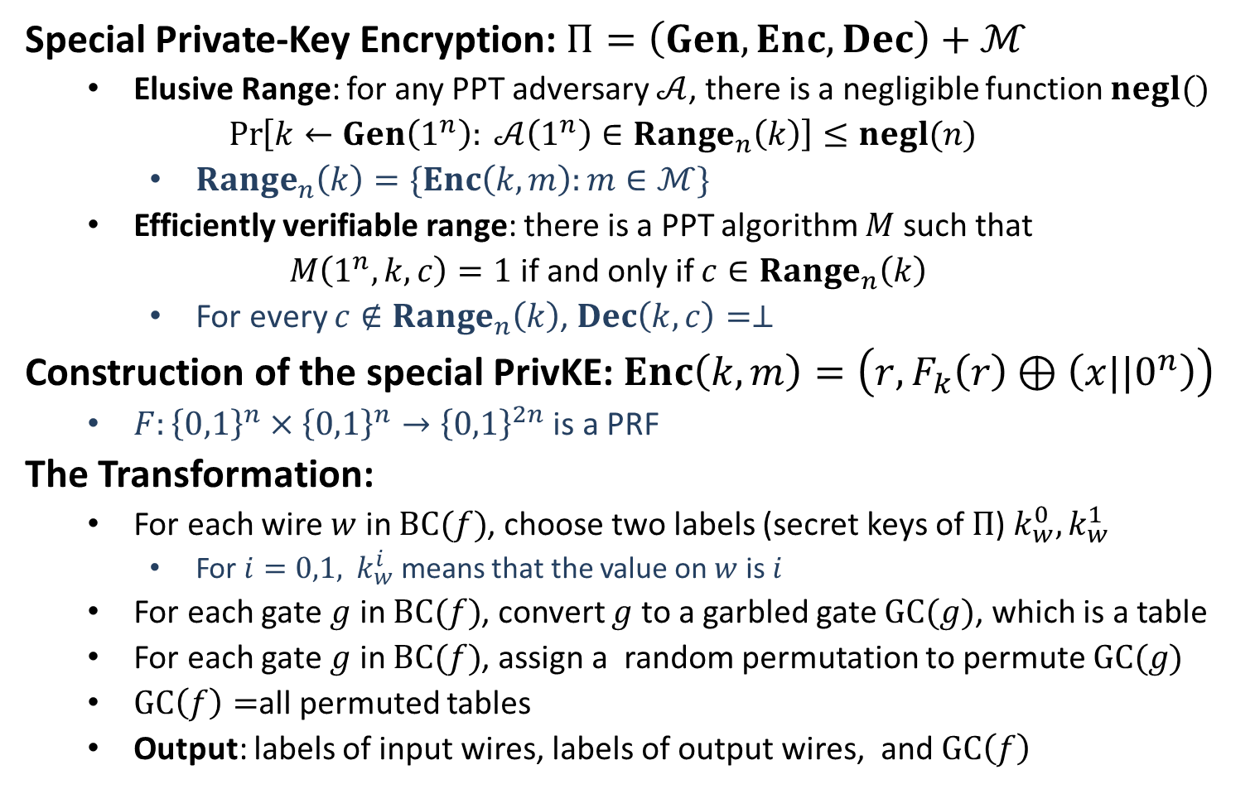
(2) Alice: $BC(f)→$garbled circuit $GC(f)$
Special Private-Key Encryption: $Π=\left(Gen,Enc, Dec\right)+ℳ$
Elusive Range: for any PPT adversary $𝒜$, there is a negligible function $negl()$
$$\operatorname{Pr}\left[k←Gen\left(1^{n}\right): 𝒜\left(1^{n}\right)∈Range_{n}\left(k\right)\right]≤negl(n)$$
$Range_{n}\left(k\right)=\{Enc\left(k,m\right):m∈ℳ\}$
Efficiently verifiable range: there is a PPT algorithm $M$ such that
$M\left(1^{n},k,c\right)=1$ if and only if $c∈Range_{n}\left(k\right)$
For every $c∉Range_{n}\left(k\right)$, $Dec\left(k,c\right)=⊥$
Construction of the special PrivKE: $Enc\left(k,m\right)=\left(r,F_{k}\left(r\right)⊕\left(x||0^{n}\right)\right)$
$F:{\left\{0,1\right\}}^{n}×{\left\{0,1\right\}}^{n}→{\left\{0,1\right\}}^{2n}$ is a PRF
The Transformation:
For each wire $w$ in $BC(f)$, choose two labels (secret keys of $Π$) $k_{w}^{0}, k_{w}^{1}$
For $i=0,1,$ $k_{w}^{i}$ means that the value on $w$ is $i$
For each gate $g$ in $BC(f)$, convert $g$ to a garbled gate $GC(g)$, which is a table
For each gate $g$ in $BC(f)$, assign a random permutation to permute $GC(g)$
$GC\left(f\right)=$all permuted tables
Output: labels of input wires, labels of output wires, and $GC\left(f\right)$

Slide 18


(2) Alice: $BC(f)→$garbled circuit $GC(f)$
$$GC(g)$$
AND gate $g$
Choose labels
Encrypted gate
Permuted Encrypted gate
Truth table

Slide 19


(2) Alice: $BC(f)→$garbled circuit $GC(f)$
$$GC(g)$$
OR gate $g$
Choose labels
Encrypted gate
Permuted Encrypted gate
Truth table

Slide 20


(2) Alice: $BC(f)→$garbled circuit $GC(f)$
$$GC(g)$$
NOT gate $g$
Choose labels
Encrypted gate
Permuted Encrypted gate
Truth table

Slide 21
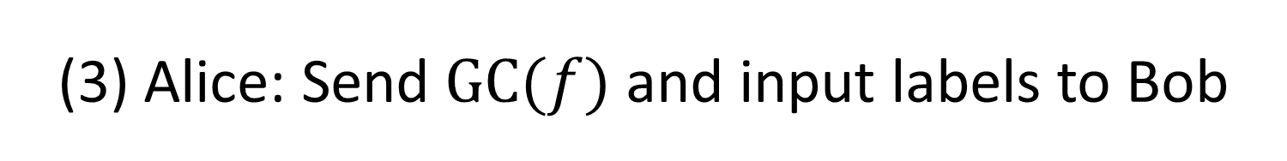
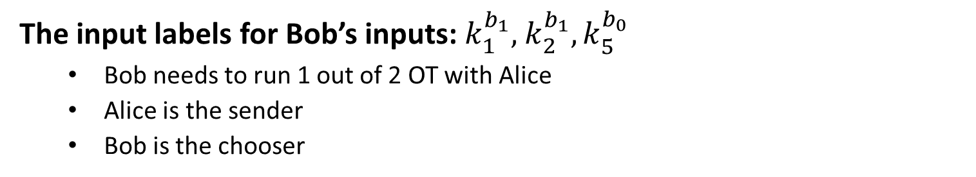
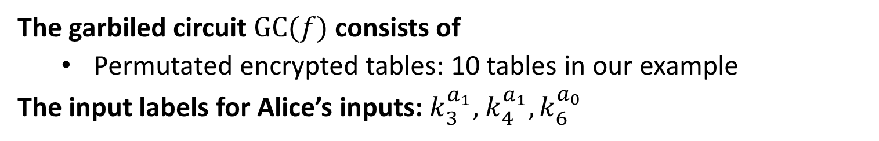
(3) Alice: Send $GC(f)$ and input labels to Bob
The garbiled circuit $GC(f)$ consists of
Permutated encrypted tables: 10 tables in our example
The input labels for Alice’s inputs: $k_{3}^{a_{1}},$ $k_{4}^{a_{1}}, k_{6}^{a_{0}}$
(4) Bob: Collect input labels from Alice
The input labels for Bob’s inputs: $k_{1}^{b_{1}},$ $k_{2}^{b_{1}}, k_{5}^{b_{0}}$
Bob needs to run 1 out of 2 OT with Alice
Alice is the sender
Bob is the chooser

Slide 22
(5) Bob: Evaluate the Garbled Circuit
Bob: decrypt the permuted encrypted table with ${(k_{u}^{a}, k}_{v}^{b})$
Bob: decrypt the permuted encrypted table with $k_{u}^{a}$
Bob: only one of the decryption is successful
Bob: the successful decryption gives $k_{w}^{g(a,b)}$
Bob: the decryption is done until the output wire is reached
Bob: send the output label to Alice
(6) Alice: Convert the output label to output

